Slide 1

Lecture 6 Cyber Security Essentials 20CYS114
-Saurabh Shrivastava
TIFAC Core in Cyber Security
Amrita Vishwa Vidyapeetham

Slide 2
DHCP
Dynamic Host Configuration Protocol
Used to dynamically assign the IP address
DHCP also assigns the subnet masks, default gateway and domain name server(DNS) address

Slide 3
Components of DHCP
DHCP Server
DHCP Client
IP address pool
Subnet Mask
Lease Time
Gateway Address

Slide 4
DHCP transactions or DHCP conversation
DHCP Discovery: The DHCP client broadcast messages to discover the DHCP servers.
DHCP Offer: When the DHCP server receives the DHCP Discover message then it suggests or offers an IP address(form IP address pool) to the client by sending a DHCP offer message to the client.
DHCP Request: In response to the offer, the client sends a DHCP Request requesting the offered address from one of the DHCP servers.
DHCP Acknowledgment: The server then sends Acknowledgment to the client confirming the DHCP lease to the client.

Slide 5
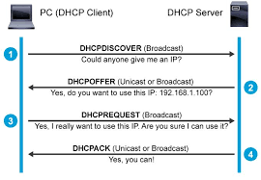
DORA

Slide 6
Subnetting
Subnetting is the practice of dividing a network into two or more smaller networks. It increases routing efficiency, which helps to enhance the security of the network and reduces the size of the broadcast domain.
A subnet mask is a 32 bits address used to distinguish between a network address and a host address in IP address. A subnet mask identifies which part of an IP address is the network address and the host address.

Slide 7
DNS (Domain Name System)
It’s a system that lets you connect to websites by matching human-readable domain names (like google.com) with the unique ID of the server where a website is stored.
DNS or Domain Name System basically translates the domain names into IP addresses and points your device in the right direction.
A domain name and its matching IP address is called a “DNS record”.

Slide 8
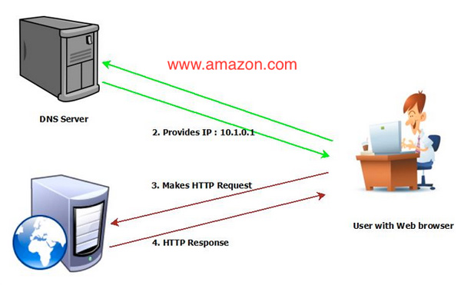
DNS working

Slide 9
DNS Hierarchy
Root DNS Server
TLD DNS Server
Authoritative DNS Server

Slide 10
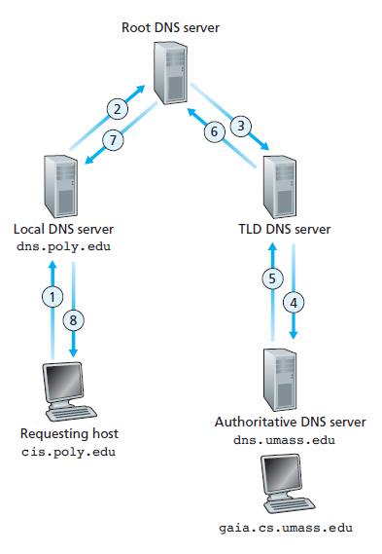
Iterative

Slide 11
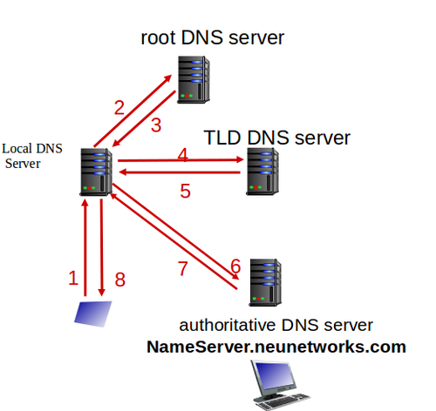
Recursive

Slide 12
References:
https://afteracademy.com/blog/what-is-dhcp-and-how-does-it-work
https://www.guru99.com/subnetting-subnet-mask.html
https://www.wpbeginner.com/glossary/dns/
https://www.cloudflare.com/en-in/learning/dns/what-is-dns/

